Slide 1


Syama Sasikumar
05/31/2023

Slide 2

Outline
Executive Summary
Introduction
Methodology
Results
Conclusion
Appendix

Slide 3
Executive Summary
Summary of methodologies
- Data collection using API and Web Scraping
- Data Wrangling
- Exploratory Data Analysis with SQL and Visualization
- Interactive Visual Analytics
- Machine Learning Prediction
Summary of all results
Exploratory Data Analysis result
Interactive analytics in Screenshots
- Predictive Analytics result from Machine Learning Lab

Slide 4
Introduction
Project background and context
SpaceX advertises Falcon 9 rocket launches on its website with a cost of 62 million dollars; other providers cost upwards of 165 million dollars each. Most of this savings is because SpaceX can reuse the first stage of the launch by re-landing the rocket to be used on the next mission. Reptation of this process will help make the price go down further. As a data scientist of a startup riveling SpaceX, the goal of this project is to create a Machine learning Pipeline to predict the landing outcome of the First stage of launch in future. This is crucial in placing the right price bid for a rocket launch.
Problems you want to find answers
Identifying all factors that influence the landing outcome
The relationship between each variables and how it is affecting the outcome.
- The best condition needed to increase the probability of successful landing.

Slide 5

Section 1

Slide 6
Methodology
Executive Summary
Data collection methodology:
- Data was gathered from an API, specifically the SpaceX REST API. This API gave us data about launches, including information about the rocket used, payload delivered, launch specifications, landing specifications, and landing outcome.
Perform data wrangling
- Performed data processing using one –hot encoding for categorical values.
Perform exploratory data analysis (EDA) using visualization and SQL
Perform interactive visual analytics using Folium and Plotly Dash
Perform predictive analysis using classification models
How to build, tune, evaluate classification models

Slide 7
Data Collection
Data collection is the process of gathering and measuring information on targeted variables in an established system, which enables the user to answer relevant questions and validate outcomes. For this project, the data set was collected by REST API and Web Scrapping.
For the REST API, it started by using the GET() request. Then, decoded the response content as json and turn it into a Pandas dataframe using json_normalize(). Then cleaned data checked for missing values and filled in with data needed.
For Web Scrapping , we use BeautifulSoup to extract the launch records as HTML table, Parse the table and convert it to a pandas dataframe for further analysis.

Slide 8
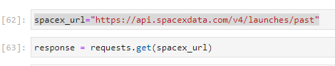
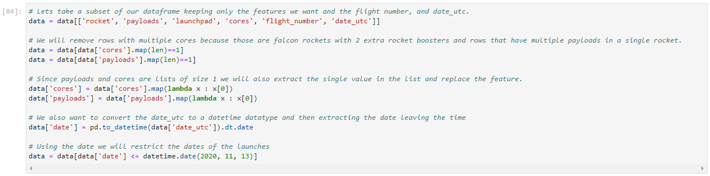
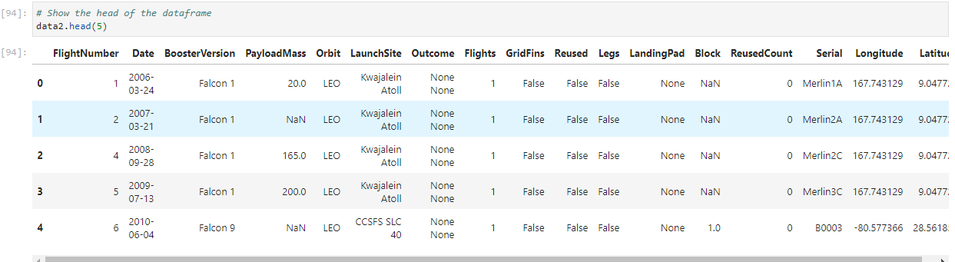
Data Collection – SpaceX API
Get Request for rocket launch data using API.
Use json_normalize method to convert json result to dataframe.
Performed data cleaning and filling the missing value.
Github link:
https://github.com/SyamaNair/CapstoneProject/blob/main/Data%20Collection%20API.ipynb

Slide 9
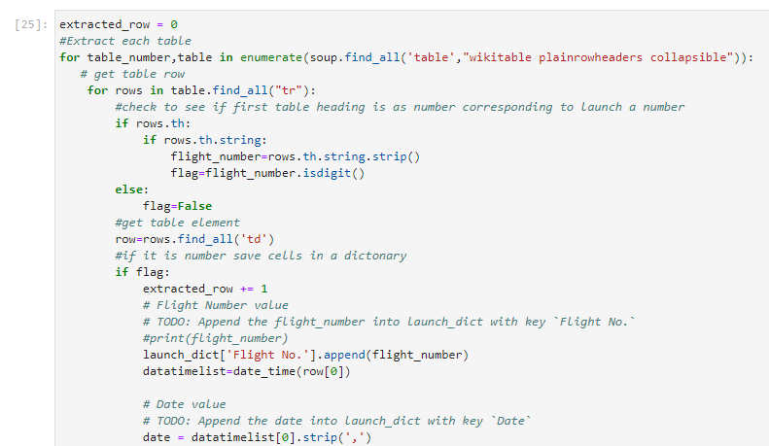
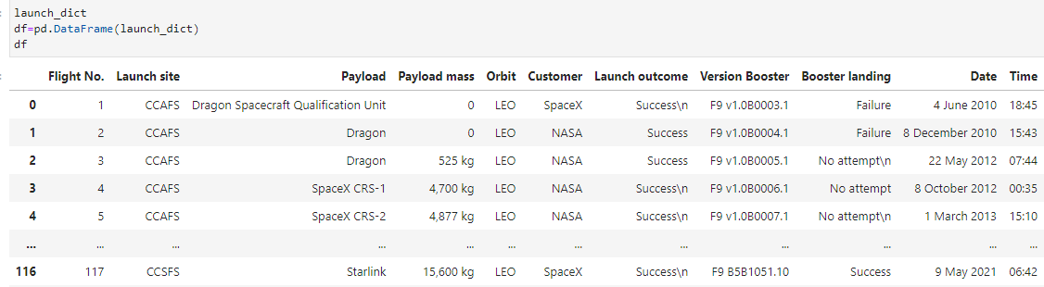
Data Collection - Scraping
Request The Falcon9 launch wiki page from URL.
Create a BeautifulSoup from the HTML response
Extract all variable names from the HTML Header.
Github Link:
https://github.com/SyamaNair/CapstoneProject/blob/main/Data%20Collection%20Web%20Scraping.ipynb

Slide 10
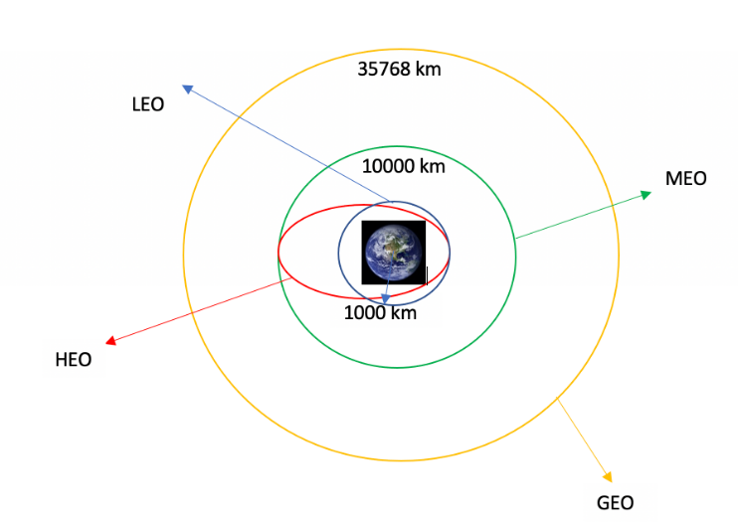
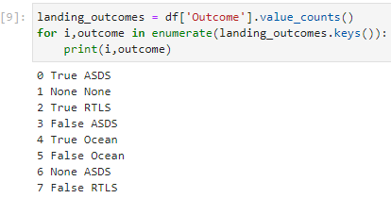
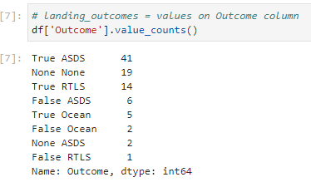
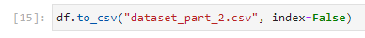
Data Wrangling
Data Wrangling is the process of cleaning and unifying complex data sets for easy access. It is the process of converting or mapping data from one raw form into another format to make it ready for further analysis like Exploratory data Analysis.
We will first calculate the number of launches on each site, then calculate the number and occurrence of mission outcome per orbit type.
We then create a landing outcome label from the outcome and export the result to a csv.
Github Link:
https://github.com/SyamaNair/CapstoneProject/blob/main/Data%20Wrangling%20Lab.ipynb

Slide 11
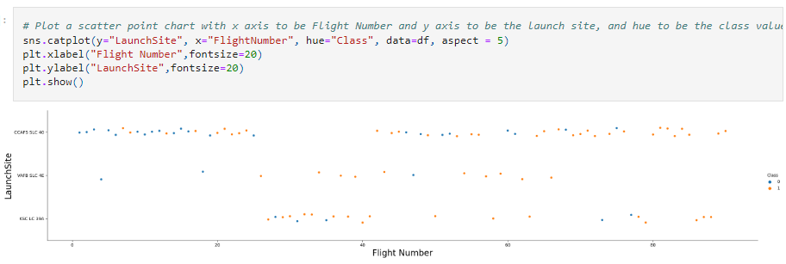
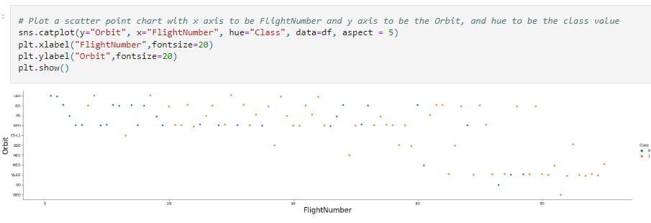
EDA with Data Visualization
We used scatter graphs to find relationship between the attributes such as :
Payload and Flight Number
Launch site and Flight Number
Payload and Launch site
Flight Number and Orbit type
Payload and Orbit type
Scatter plots show dependency of attributes on each other. Once a pattern is determined from the graphs it is easy to see which factors affect the success of the landing outcome the most.

Slide 12
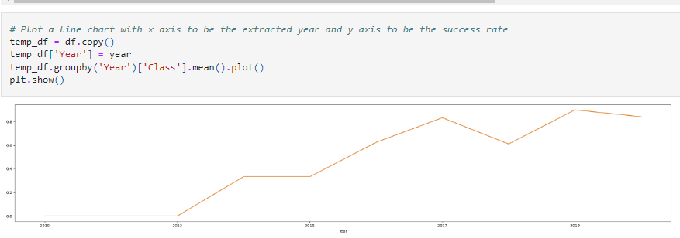
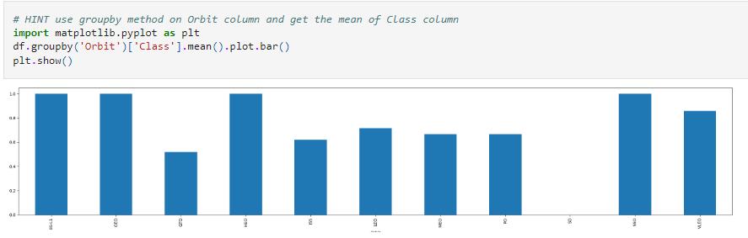
EDA with Data Visualization
We used visualization tools such as Bar graph and Line plots graph for further analysis.
Bar graphs easily interprets relationship between attributes. We used the bar graph to determine which orbits have the highest probability of success.
Line graph shows trends or patterns of the attribute over time and here we sed it to see the launch success yearly trend.
We then use Feature Engineering for success prediction in the future module by creating dummy variables to categorical columns.
Github Link:
https://github.com/SyamaNair/CapstoneProject/blob/main/EDA%20with%20Visualization.ipynb

Slide 13
EDA with SQL
Using SQL we performed queries to get better understanding of the data set and and to derive data. Following are the few data sets we derived.
Displayed the names of the unique launch sites in the space mission
Displayed 5 records where launch sites begin with the string 'CCA’
Displayed the total payload mass carried by boosters launched by NASA (CRS)
Displayed average payload mass carried by booster version F9 v1.1
Listed the date when the first successful landing outcome in ground pad was achieved
Listed the names of the boosters which have success in drone ship and have payload mass greater than 4000 but less than 6000
Listed the total number of successful and failure mission outcomes
Listed the names of the booster_versions which have carried the maximum payload mass. Use a subquery
Listed the records which will display the month names, failure landing_outcomes in drone ship, booster versions, launch_site for the months in year 2015
Ranked the count of successful landing_outcomes between the date 04-06-2010 and 20-03-2017 in descending order.
Github Link : https://github.com/SyamaNair/CapstoneProject/blob/main/EDA%20with%20SQLite.ipynb

Slide 14
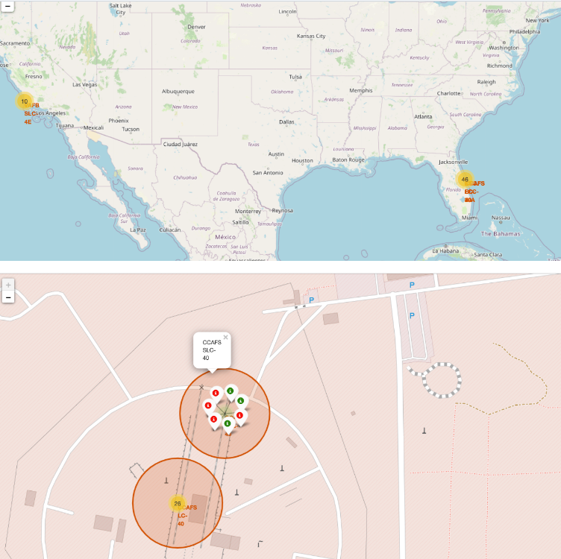
Build an Interactive Map with Folium
We used Folium to launch the visualized data into an interactive map. We took the latitude and longitude coordinates at launch site and added a circle marker around each launch site with a label of the name of the launch site.
Assigned the dataframe launch outcomes (failure, success) to classes 0 and 1 with Red and Green markers on the map in MarkerCluster().
We then used formula to calculate the distance of the launch sites to various landmark to find answer to the questions of :
Are launch sites in close proximity to railways?
Are launch sites in close proximity to highways?
Are launch sites in close proximity to coastline?
Do launch sites keep certain distance away from cities?
Github Link: https://github.com/SyamaNair/CapstoneProject/blob/main/Interactive%20Visual%20Analytics%20with%20Folium%20lab.jupyterlite.ipynb

Slide 15
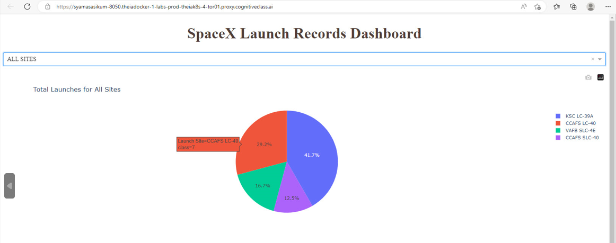
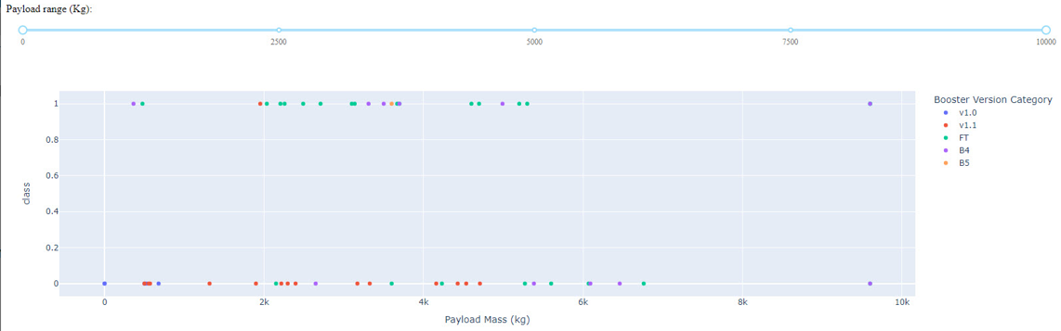
Build a Dashboard with Plotly Dash
Using Plotly an interactive Dashboard was built. It allows user to adjust data sets and get results in a visual output.
Pie charts and dropdowns showed the total launches by certain sites.
Also plotted scatter graph showing the relationship with Outcome and PayloadMass (kg) for the different booster version.
Github Link:
https://github.com/SyamaNair/CapstoneProject/blob/main/SpaceX_Dashboard_Code.py

Slide 16
Predictive Analysis (Classification)
Building the Model
Load the dataset into NumPy and Pandas.
Transform the data and then split into the training and test data sets
Decide which type of Machine Language to use
Set the parameters and algorithms and fit it to dataset
Evaluating the Model
Check the accuracy for each model
Get tuned hyperparameters for each type of algorithms
Plot the confusion matrix.
Improving the Model
User Feature Engineering and Algorithm tuning
Find the Best Model
The model with the best accuracy score will be the best performing model
Githublink:
https://github.com/SyamaNair/CapstoneProject/blob/main/SpaceX_Dashboard_Code.py

Slide 17
Results
Exploratory data analysis results
Interactive analytics demo in screenshots
Predictive analysis results

Slide 18

Section 2

Slide 19
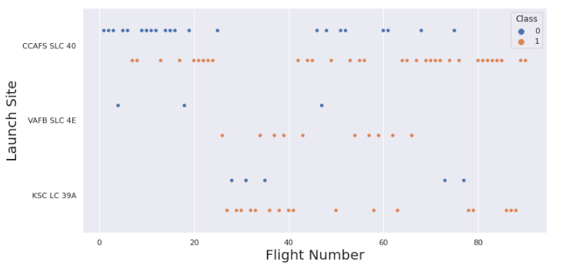
Flight Number vs. Launch Site
This scatter plot shows that the larger the flights to the amount of the launch site, the greater the success rate will be.
The site CCAFS SLC40 shows the least of this pattern.

Slide 20
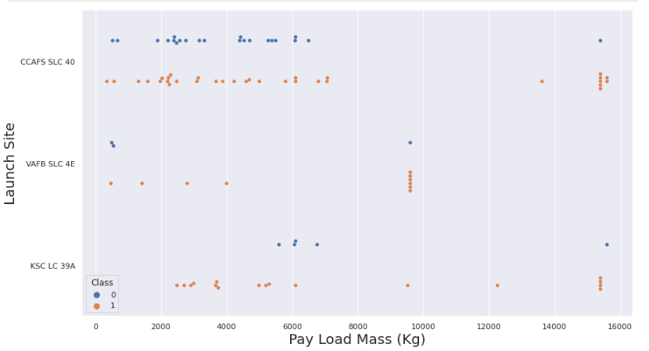
Payload vs. Launch Site
This scatter plot shows once the pay load mass is greater than 7000kg, the probability of the success rate will be highly increased.
However, there is no clear pattern to say the launch site is dependent to the pay load mass for the success rate.

Slide 21
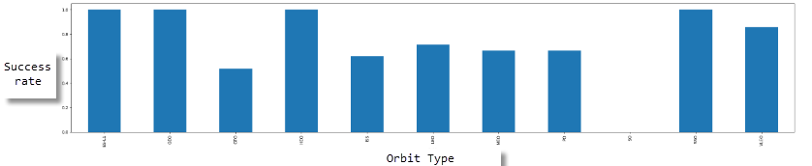
Success Rate vs. Orbit Type
This figure depicted the possibility of the orbits to influence the landing outcomes as some of the orbits has 100% success rate such as SSO, HEO, GEO and ES-L1 while SO orbit produced 0% rate of success.
However, deeper analysis show that some of this orbit s has only 1 occurrence such as GEO, SO, HEO and ES-L1 which mean this requires more data in the dataset to see a pattern or trend before a conclusion can be arrived at.

Slide 22
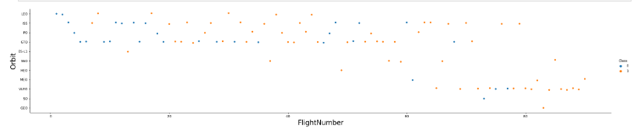
Flight Number vs. Orbit Type
This scatter plot shows that generally , the larger the flight number on each orbit, the greater the success rate, especially for LEO orbit, except for GTO orbit which depicts no relationship between both attributes.
Orbit that only has 1 occurrence should also be excluded from the above statement as its’s needed more dataset.

Slide 23
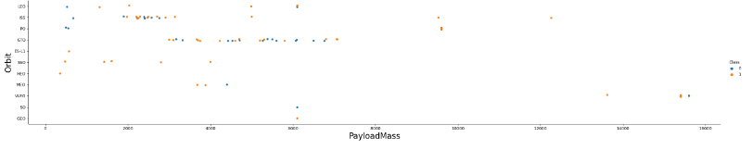
Payload vs. Orbit Type
Heavier payload has positive impact on LEO, ISS, and PO orbits. However, it has negative impact on MEO and VLEO orbits.
GTO orbit seems to depict no relation between the attributes.
Meanwhile SO, GEO and HEO orbits need more data to see any pattern to make predictions.

Slide 24
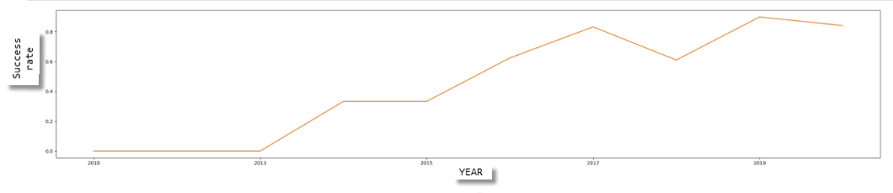
Launch Success Yearly Trend
This figure depicts the increasing trend from the year 2013 to 2020. If the trend continues in coming years, then the success rate will steadily increase.

Slide 25
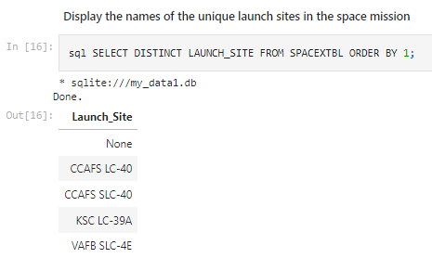
All Launch Site Names
Here we used the sql key word ‘Distinct’ to get back the unique launch sites from SpaceX data table. It returned the 4 unique launch sites from the data set.

Slide 26
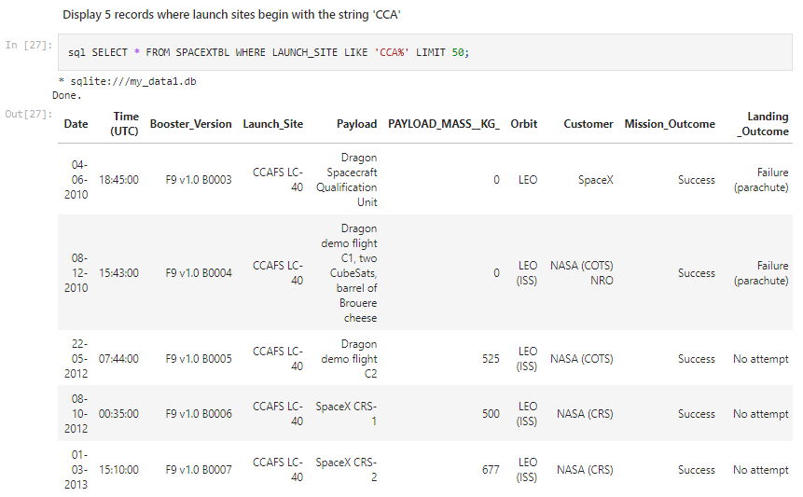
Launch Site Names Begin with 'CCA'
We used key words ‘like’ to pick up sites beginning with ‘CCA’ and set the record ‘limit’ to 50. So, it returned 50 records of which 5 are shown here.

Slide 27
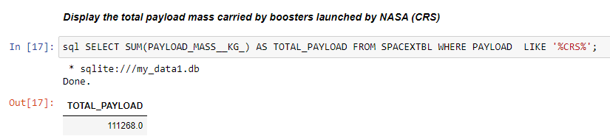
Total Payload Mass
Calculated the total payload mass carried by the boosters from NASA using the above query.

Slide 28
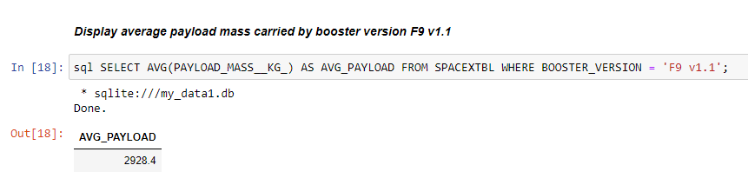
Average Payload Mass by F9 v1.1
Calculated the average payload mass carried by booster version F9 v1.1 as 2928.4

Slide 29
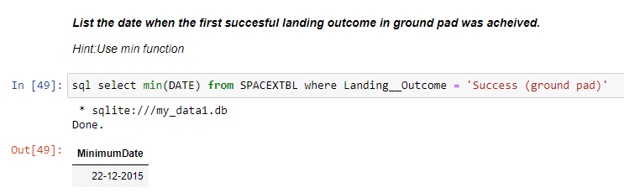
First Successful Ground Landing Date
Used the sql Min() function to get the result. We got the result as 22nd of December 2015 as the first successful ground landing date.

Slide 30
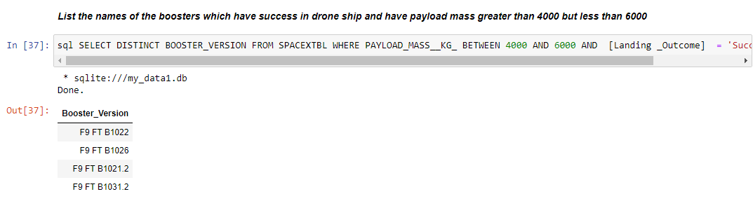
Successful Drone Ship Landing with Payload between 4000 and 6000
Use of ’WHERE’ clause to filter for boosters which have successfully landed on drone ship and applied the ‘AND’ condition to determine successful landing with payload mass greater than 4000 but less than 6000.

Slide 31
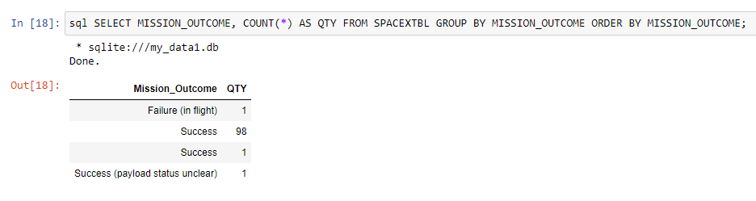
Total Number of Successful and Failure Mission Outcomes
We used COUNT function to to get the counts of Success and Failure mission outcomes.

Slide 32
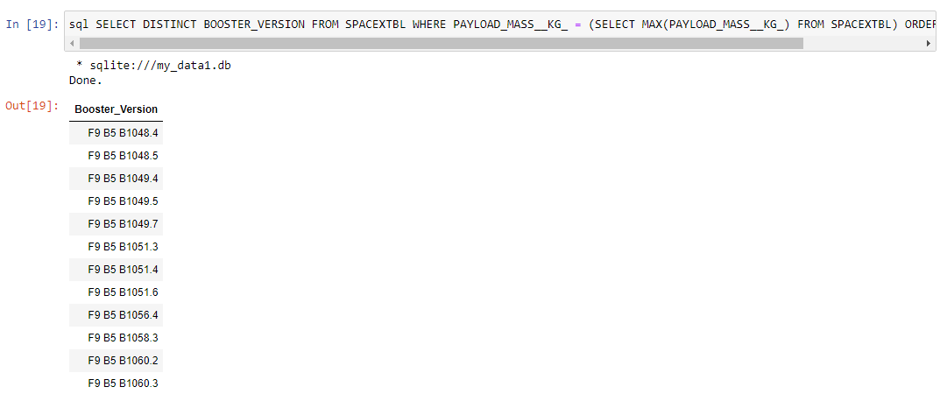
Boosters Carried Maximum Payload
We determined the Booster version that has carried the maximum payload using subquery, WHERE clause, Max() function and ORDERBY clause.

Slide 33
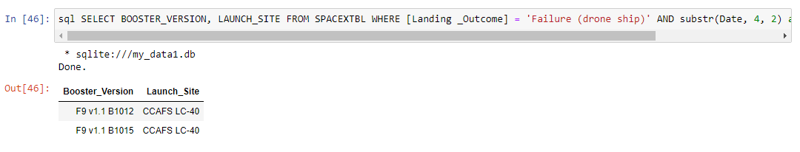
2015 Launch Records
Used combination of WHERE clause, AND, SUBSTR() conditions to filter for failed landing outcomes in drone ship, their booster versions and launch site names for the year 2015.

Slide 34
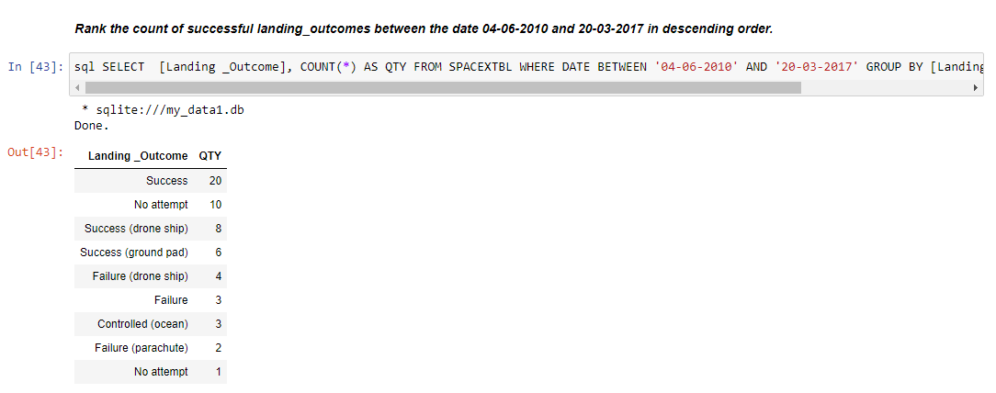
Rank Landing Outcomes Between 2010-06-04 and 2017-03-20
Selected landing outcomes and the COUNT of landing outcomes from the data and used the WHERE clause to filter for landing outcomes BETWEEN 04-06-2010 and 20-03-2017. Also applied GROUP BY clause to group the outcomes and ORDERBY to order the grouped landing outcome in descending order.

Slide 35

Section 3

Slide 36
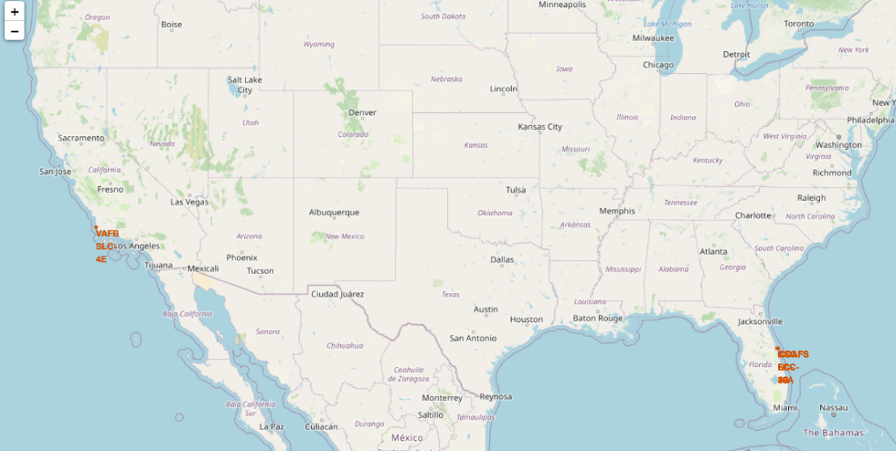
Location of Launch Sites
Shows map of United States with the launch sites marked.

Slide 37
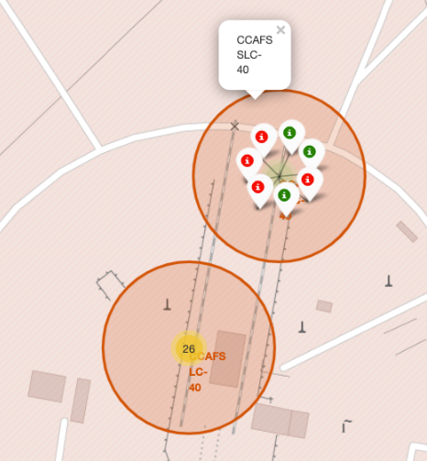
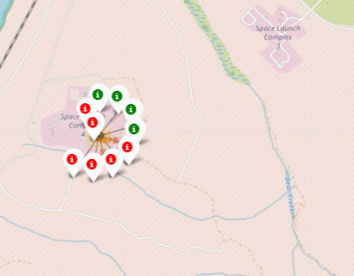
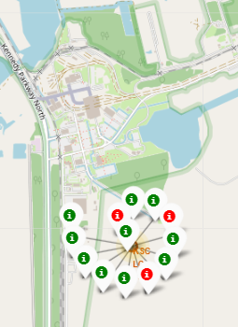
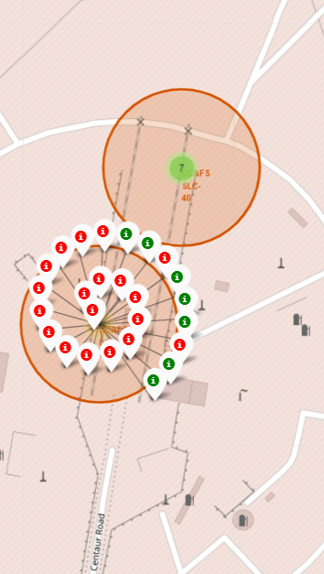
Markers showing Launch sites with label
CA launch site
FL launch sites
TX launch site
FL launch sites
Launch sites are shown with successful landings in Green and failures in Red.

Slide 38
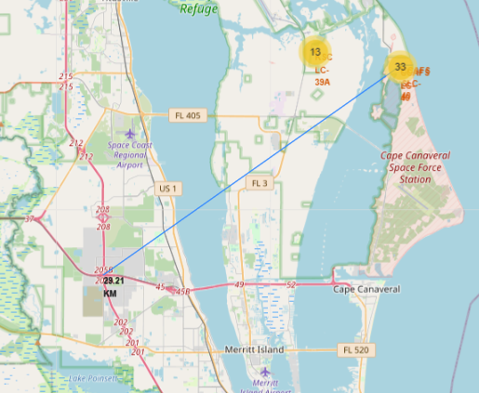
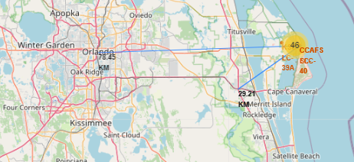
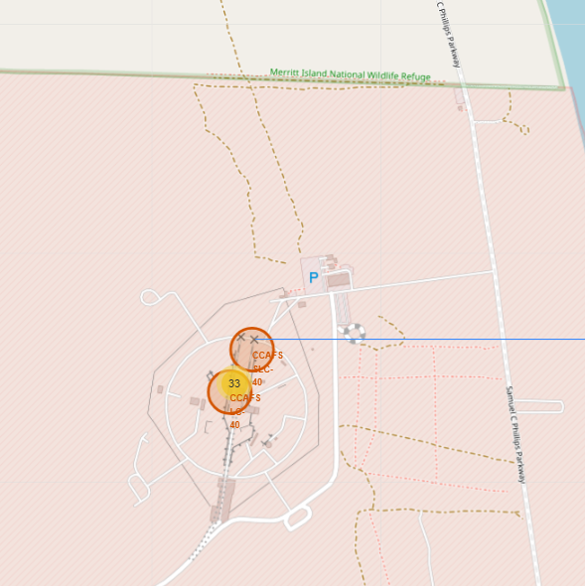
Launch site to Landmarks
To Florida city
To highway
To nearest coastline
Are launch sites in close proximity to railways? No
Are launch sites in close proximity to highways? No
Are launch sites in close proximity to coastline? Yes
Do launch sites keep certain distance away from cities? Yes

Slide 39

Section 4

Slide 40
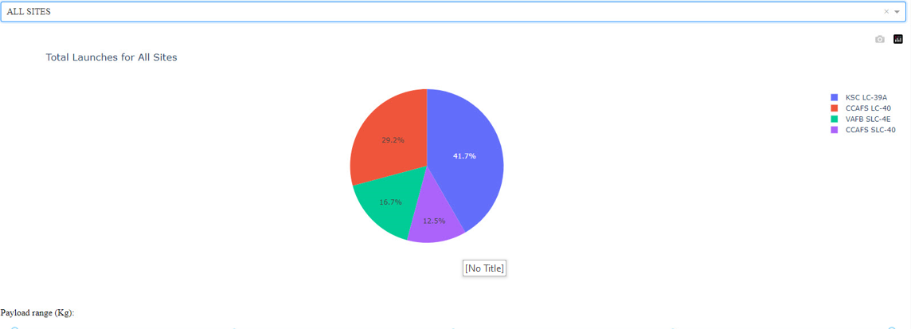
Success Percentage by each Launch site
Here we see that KSC LC-39A has the most successful launches compared to all other sites.

Slide 41
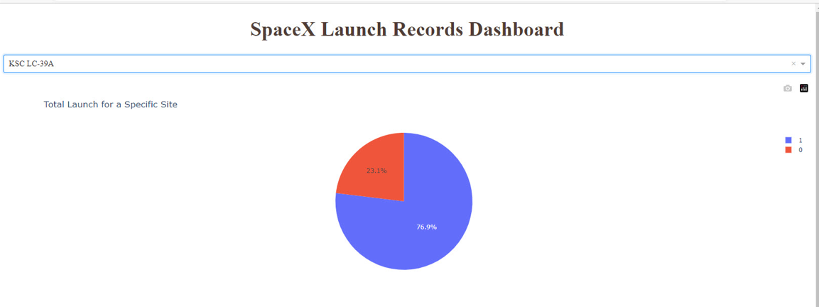
Highest launch Success Ratio : KSC LC -39A
The launch site KSC LC-39A had 76.9% Success rate and 23.1% Failure rate.

Slide 42
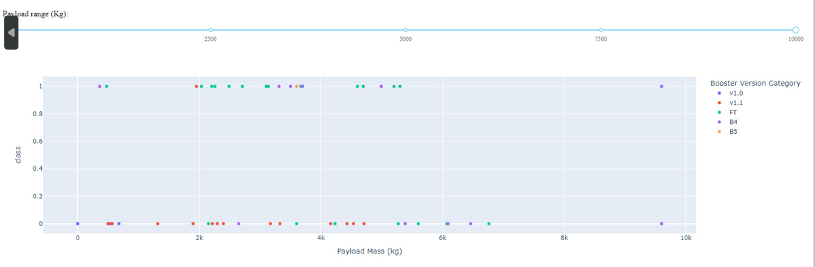
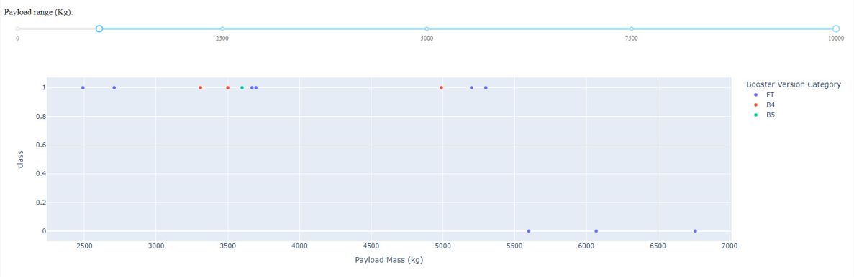
Payload vs Launch outcome Scatter Plot
We see that for all the success rate for low weighted Payload is higher than heavy weighted Payload
Scatter plot
Scatter plot with slider

Slide 43

Section 5

Slide 44
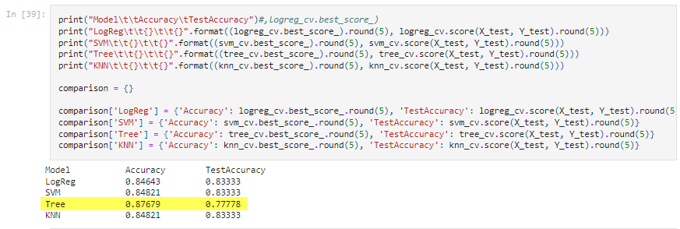
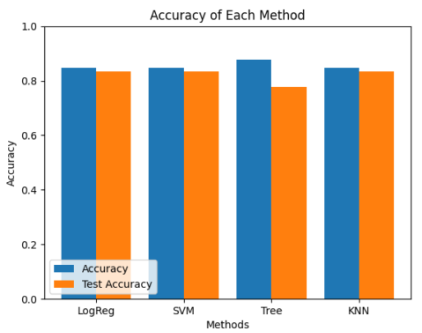
Classification Accuracy
We identified the Tree Algorithm as the best algorithm with highest classification accuracy.

Slide 45
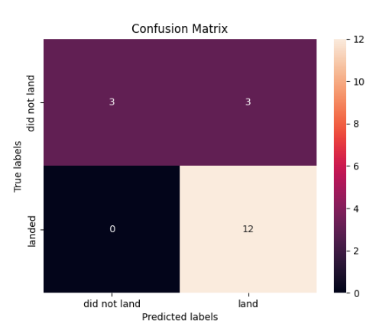
Confusion Matrix
The confusion matrix for the decision Tree classifier shows that the classifier can distinguish between different classifiers. The major problem is the False positives that is unsuccessful landing marked as successful landing by the classifier.

Slide 46
Conclusions
In conclusion
The Tree classifier proved to be the best machine Learning tool for this data set
The low weighted payloads performed better than the heavy weighted payloads.
KSC LC -39A had the most successful launches, 76.9%, compared to other sites.
SSO orbit has the most success rate that is 100 % and more than once.
Starting from 2013 the success rate has increased with passing years.

Slide 47
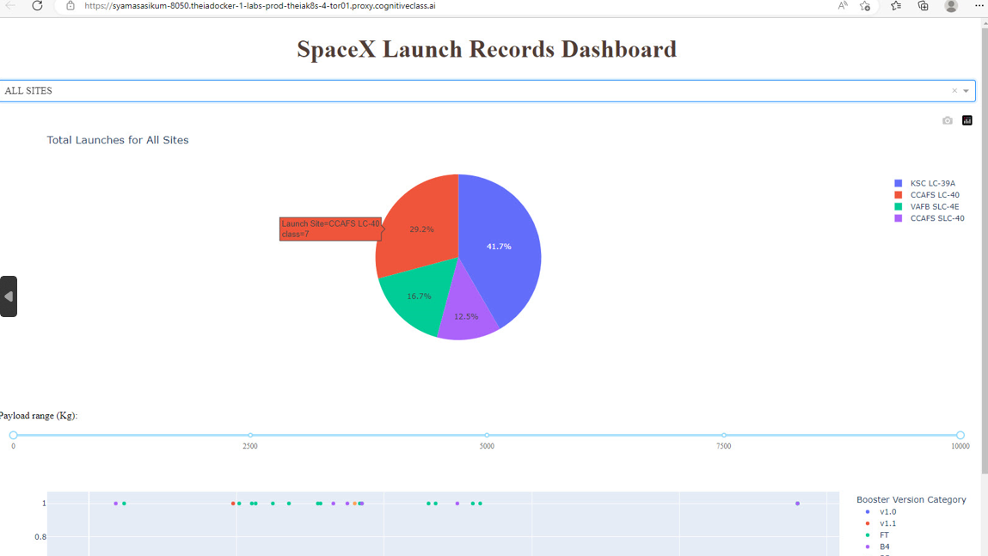
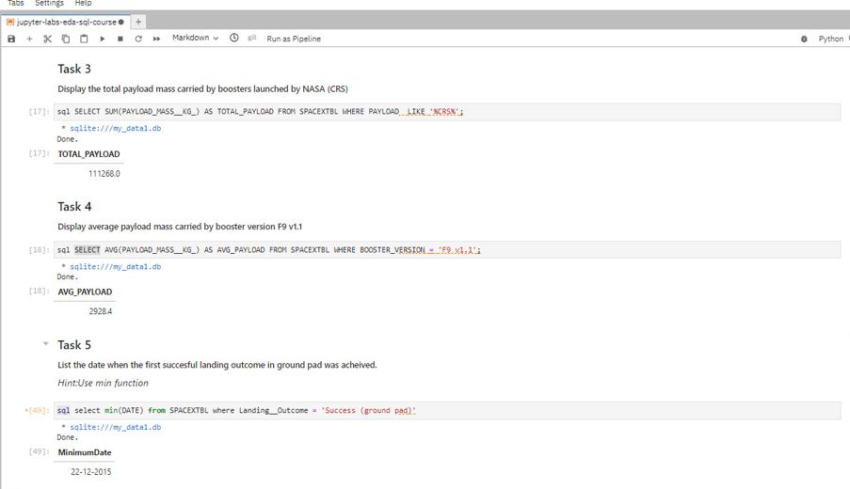
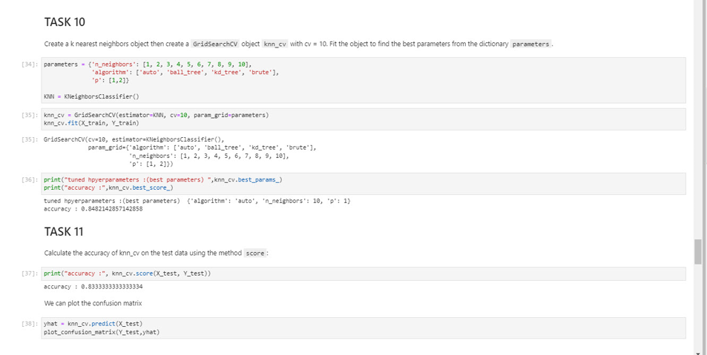
Appendix
Plotly Dashboard
SQL task
Machine Learning Task

Slide 48


